Slide 1

PLAY N’ LEARN
CREATED BY: ERIC, NIRAV, KARAN, VIDHI

Slide 2

CONCEPT
It is an application for 7-12 years old kids
The intent of this app is to introduce a fun way of learning a trending subject matter for children in school
The app focuses on basic coding terminology and definitions through interactive games

Slide 3
IDEA BEHIND THE APP
Educating kids to coding terminology
The purpose is introduce the word “Coding”

Slide 4
DESIGN
The app has various languages like HTML, CSS, JAVASCRIPT, etc.
After the language selection, they can navigate through different levels like Beginner, Intermediate and Expert
The games that are available:
TRIVIA GAME
FILL IN THE BLANKS
MEMORY GAMES

Slide 5
TECHNOLOGIES USED
HTML
CSS
BOOTSTRAP
JAVA
JQUERY
MYSQL
SEQUELIZE
NODE- EXPRESS
MATERIALIZE
GIPHY API
BCRYPT-NODE.JS

Slide 6
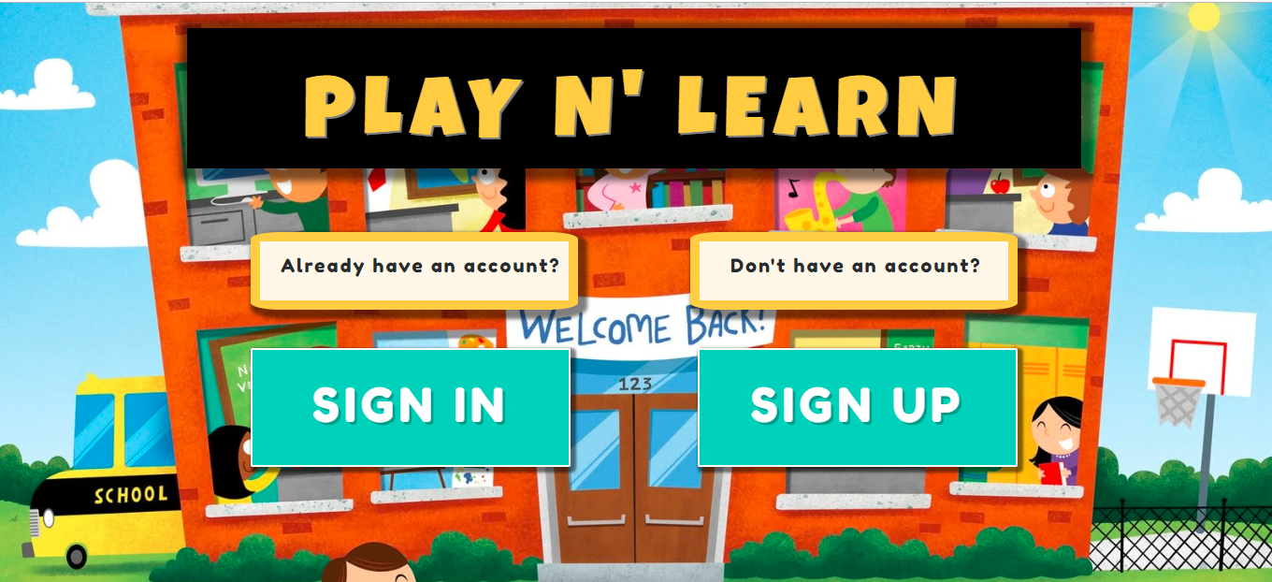
APPLICATION IN ACTION

Slide 7
FUTURE DEVELOPMENT
Progress Report
More interactive and visual games
Implementing “Bcrypt” completely
Adding games to all the other languages

Slide 8
THANK YOU !

